Slide 1
Tensor Flow:
Introduction
By: Denis Kazakov
CSCI 5922: Neural Networks & Deep Learning

Slide 2
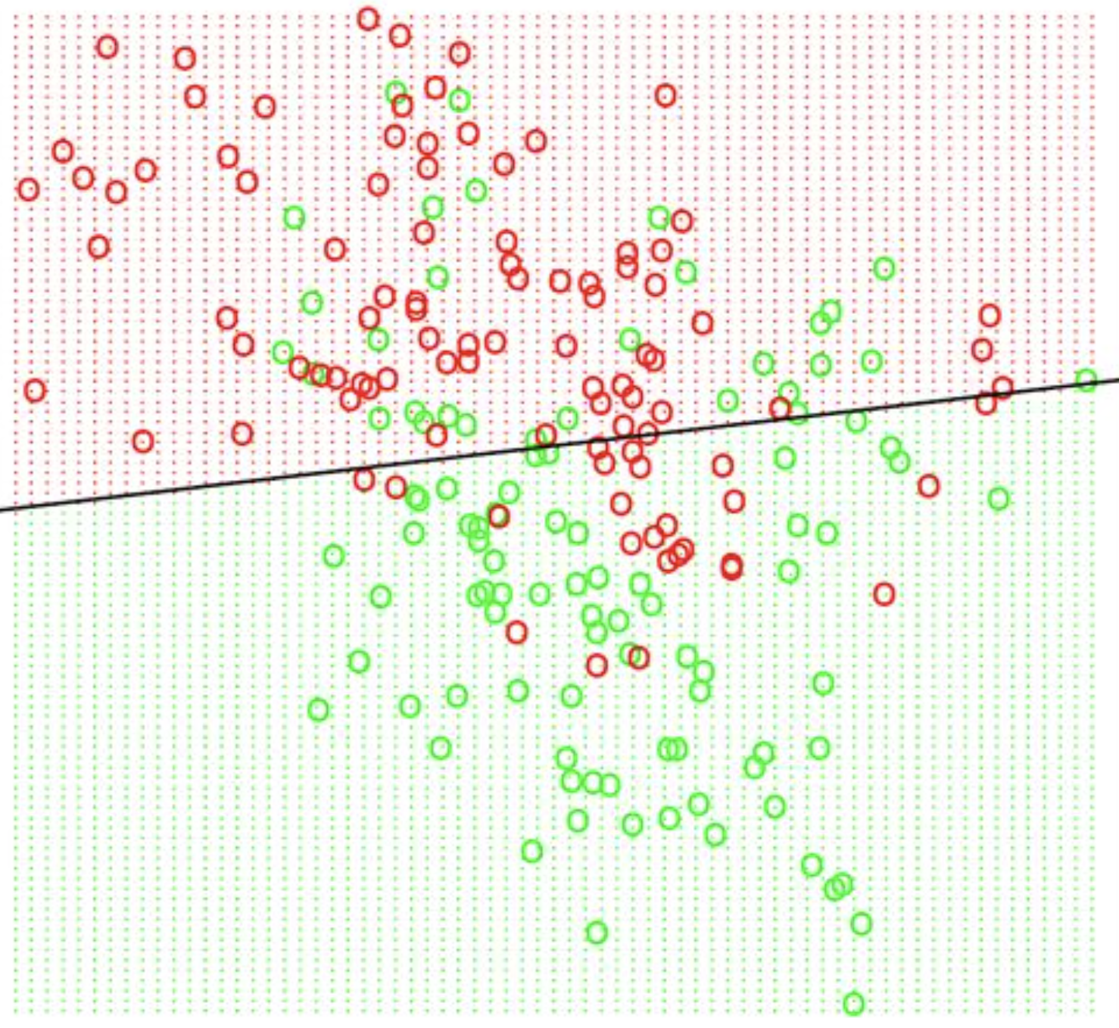
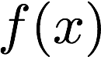
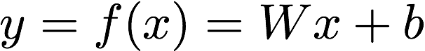
y - prediction class/quantity
x - input characteristics
f(x) - ML model

Slide 3
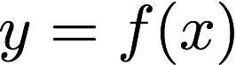
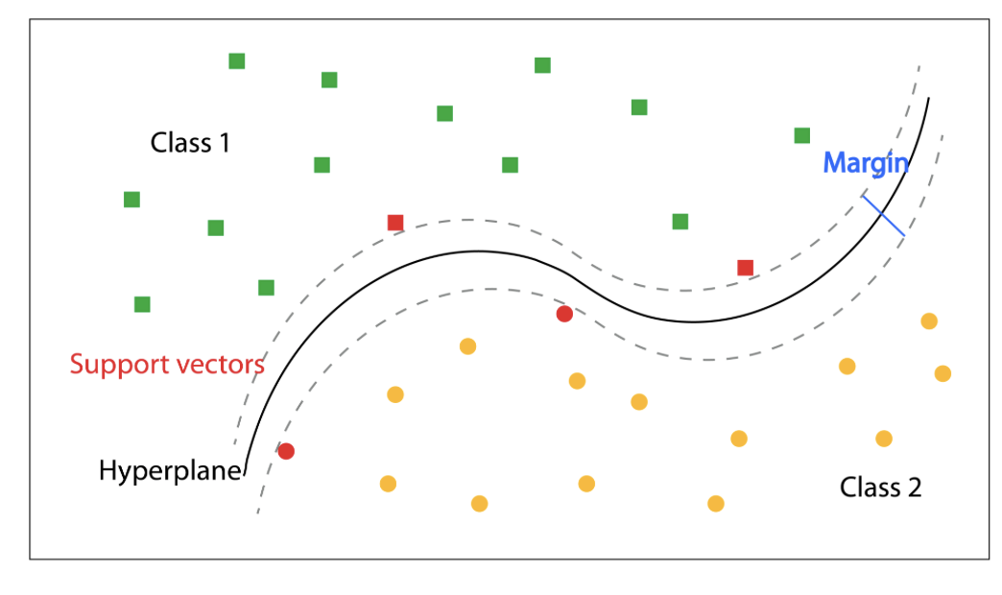
– nonlinear function

Slide 4
For each ML model:
Initialize
Test
Update
“Forward”
“Backward”

Slide 5
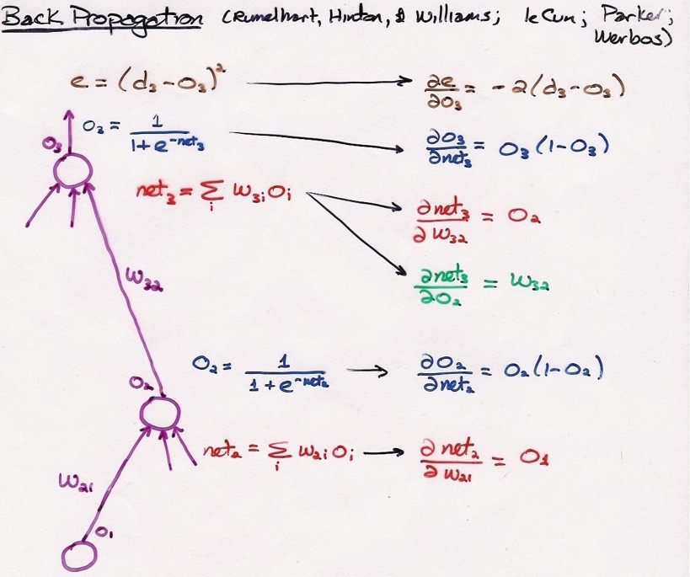
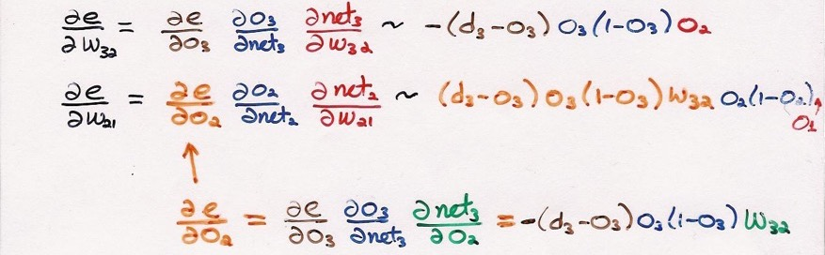
Update
“Backward”

Slide 6
Numpy vs Tensorflow
Numpy – API for tensors.
Tensorflow – API for tensors, which automatically computes derivatives in a constructed computation graph.

Slide 7
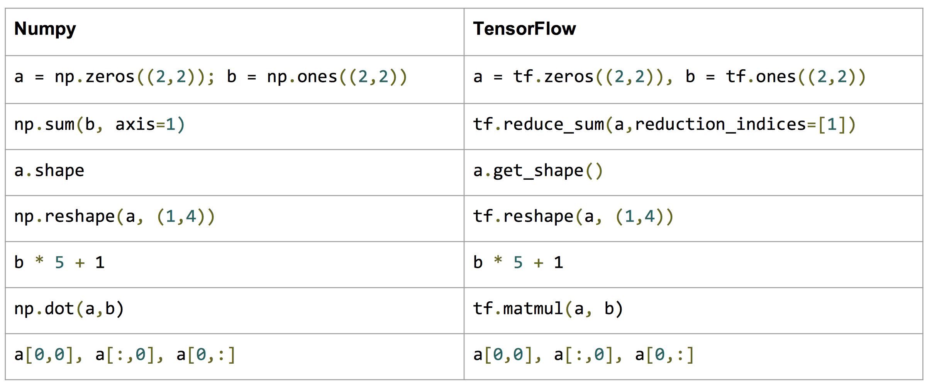
Numpy vs Tensorflow

Slide 8
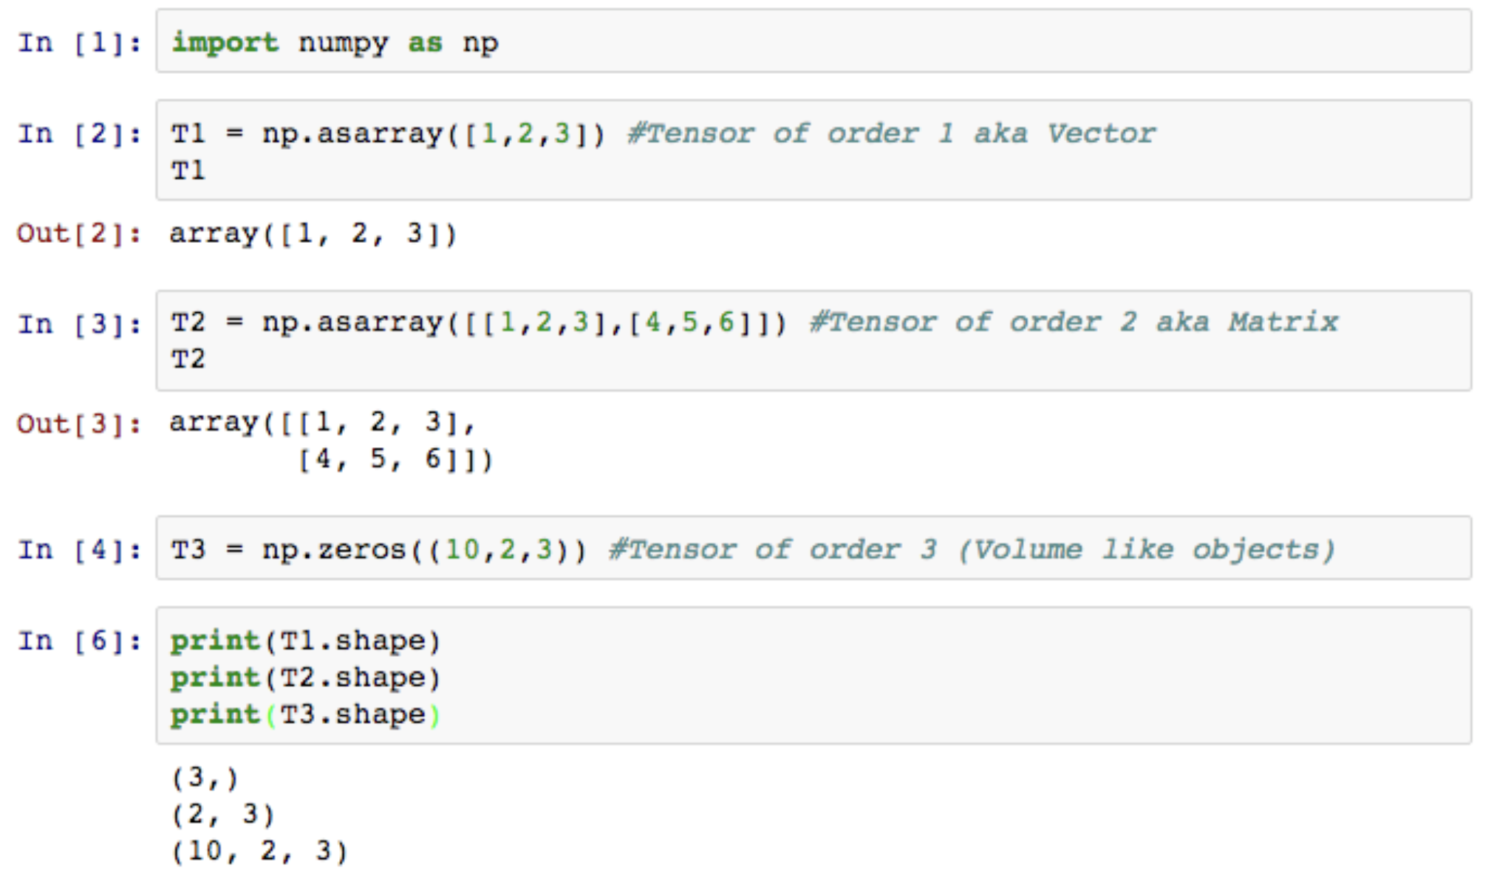
Tensors

Slide 9
Tensor Operations
Just like regular Linear Algebra:
*Ex: (a,b,c) – tensor of shape (a,b,c)
# i.e. we project b – dimensional space into c-dimensional space
tf.matmul((a, b), (b, c))= (a, c)
(a,b) * (b,c) – not valid (not all elements of the first matrix can be mapped to second matrix)
# automatically expands dimensions for *, /, +, -
(a, b, c) + (c) = (a, b, c) ⬄ (a, b, c) + (1, c) = (a, b, c) ⬄ (a, b, c) + (1, 1, c) = (a, b, c)
(a, b, c) * (b, c) = (a, b, c) ⬄ (a,b,c) * (1, b, c)
(a, b) + (a, 1) = (a, b), but (a, b) + (a) – not valid (since final dimensions don’t match)
(i.e. dimension of 1 is a way to tell tf or np what dimensions we want to be automatically matched during computation)

Slide 10
Balancing dimensions
tf.expand_dims(tensor, 2)
tf.transpose(tensor, [1,0,2])
tf.reduce_sum(tensor, axis=2) # collapsed dimensions
Collapsable functions: max/min, average, sum etc.

Slide 11
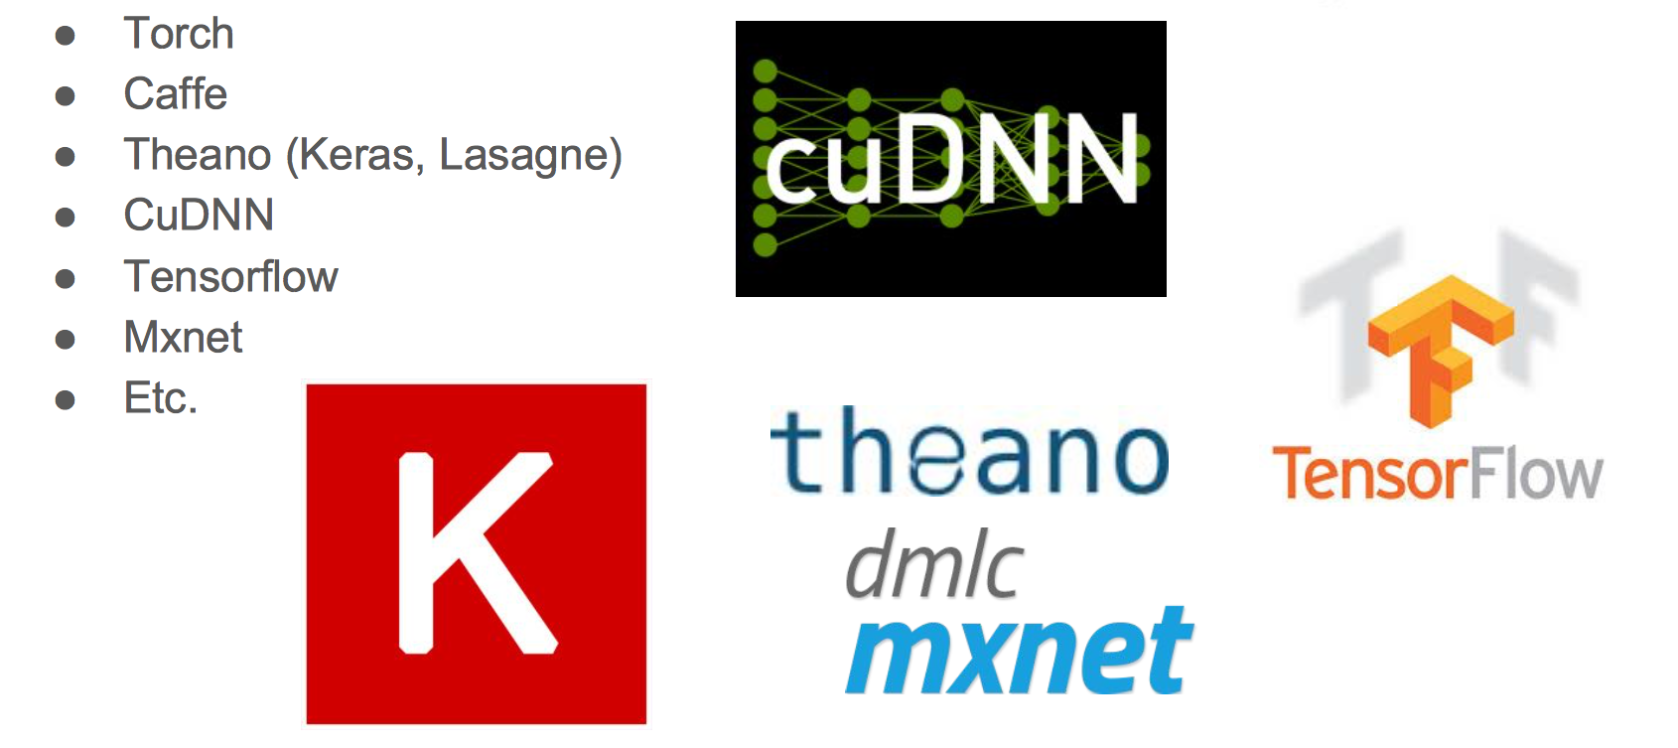
Why Tensorflow?

Slide 12
Why Tensorflow?
Ease of use for writing custom neural network models.
Great support from Google.

Slide 13
Computation Graph
Recall:
Initialize
Test
Update
“Forward”
“Backward”

Slide 14
Computation Graph
Auto-differentiation:
Is ~chain rule:
Reverse mode automatic differentiation lets you calculate gradients much more efficiently than forward mode automatic differentiation.(source)

Slide 15
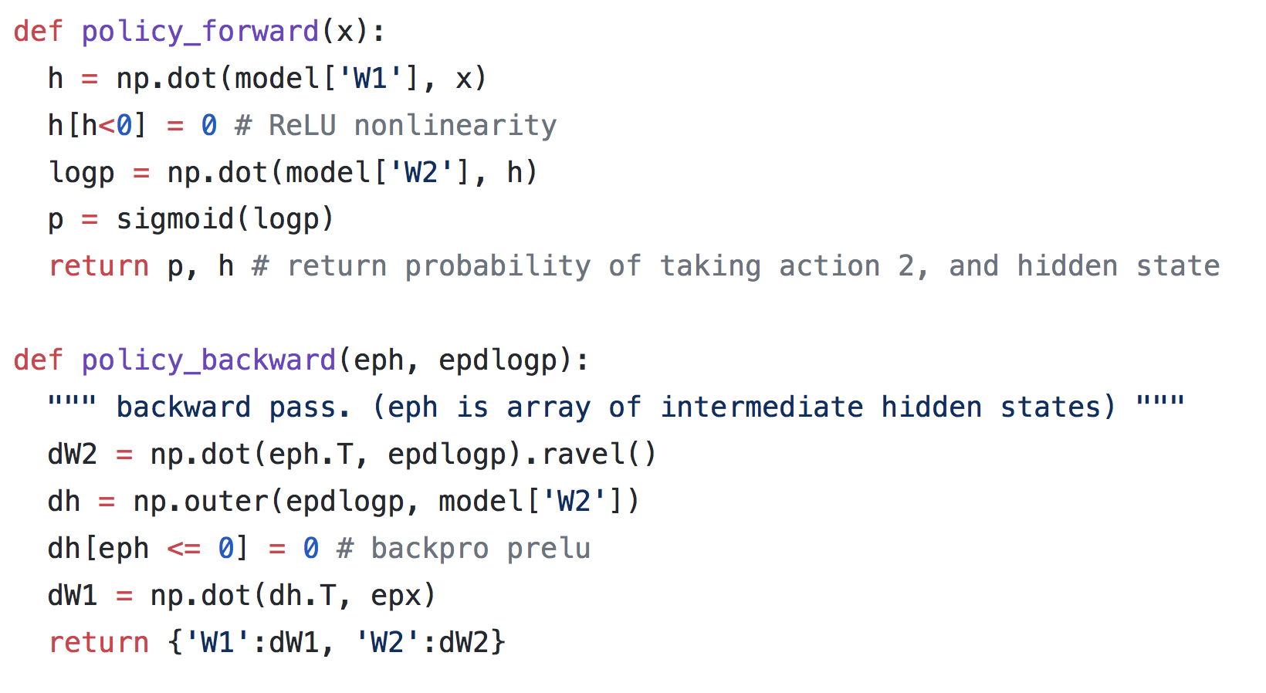
Computation Graph
Auto-differentiation example: (Karpathy)

Slide 16
Computation Graph

Slide 17
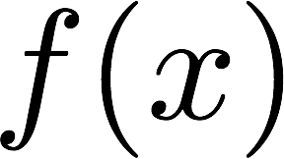

Computation Graph
We “feed” this into the graph
We make this as a computation graph

Slide 18

Computation Graph
* TensorFlow computations define a computation graph that has no numerical value until evaluated!
1) Initialization
Defining our graph structure
2) Compilation
Letting TF compile our defined graph.
Checks for shape errors (structure error).
3) Evaluation
Put number into our compiled graph.
Numerical errors (ex: NaN).
Gradient based updates.

Slide 19
Graph: Initialization
f(x)-graph:
tf.placeholder(): empty tensor, where the input goes (empty space that gets filled in with input x)
tf.variable(name=‘’, value): trainable tensor (unless otherwise specified)
+, -, /, * … : operations that define the interaction between tensors.

Slide 20
Graph: Compilation
Sessions:
session = tf.Session()
Variable initializer:
tf.reset_default_graph() # “flushes” existing graph
init = tf.global_variables_initializer()
# this will instantiate all your variables.
# nothing is created until this point.
session.run(init)

Slide 21
Graph: Evaluation
Run:
# actually runs the code
sess.run([train_op], feed_dict={X: […], y: […]})
feed & fetch:
var1_val, var2_val = sess.run([var1, var2],
feed_dict={X: […], y: […]})
“fetch”
“feed”

Slide 22
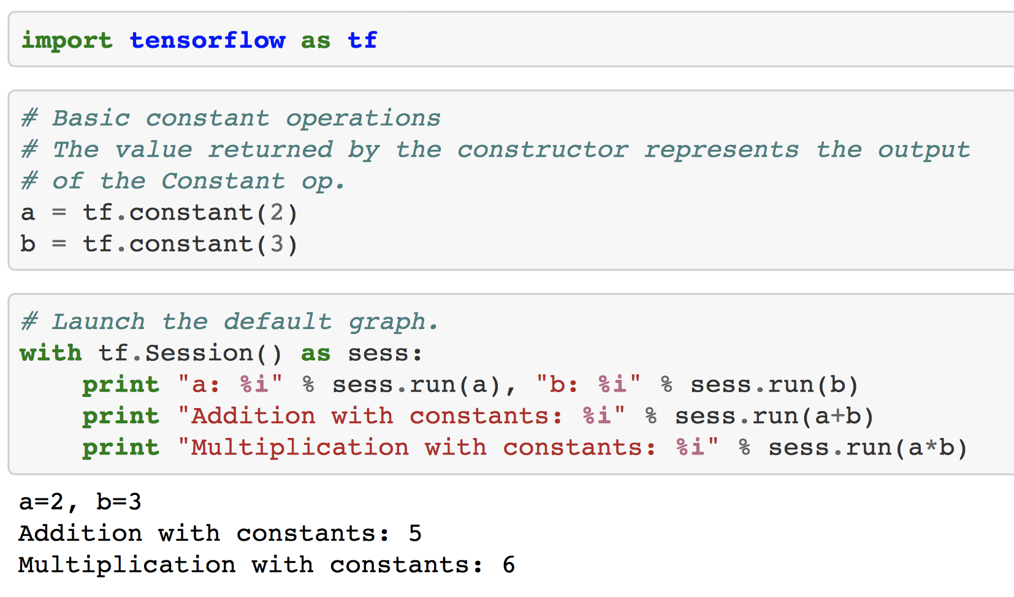

Slide 23
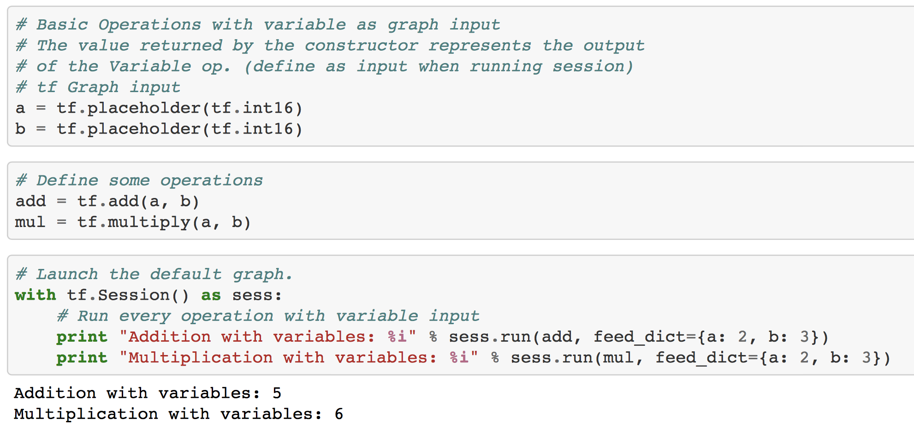

Slide 24
Training (formatted as a variable evaluation)
Optimizers:
Optimizer = tf.train.GradientDescent()
# Gradient based “update” to all the variables that loss depends on
# a bunch of stuff happens behind the scenes in this step (formatting all the update rules)
train_op = optimizer.minimize(loss)

Slide 25
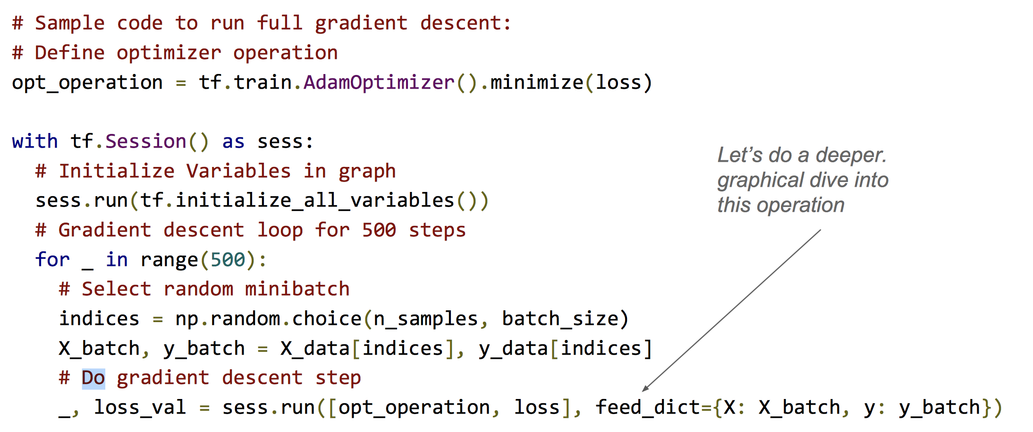
Linear regresssion

Slide 26
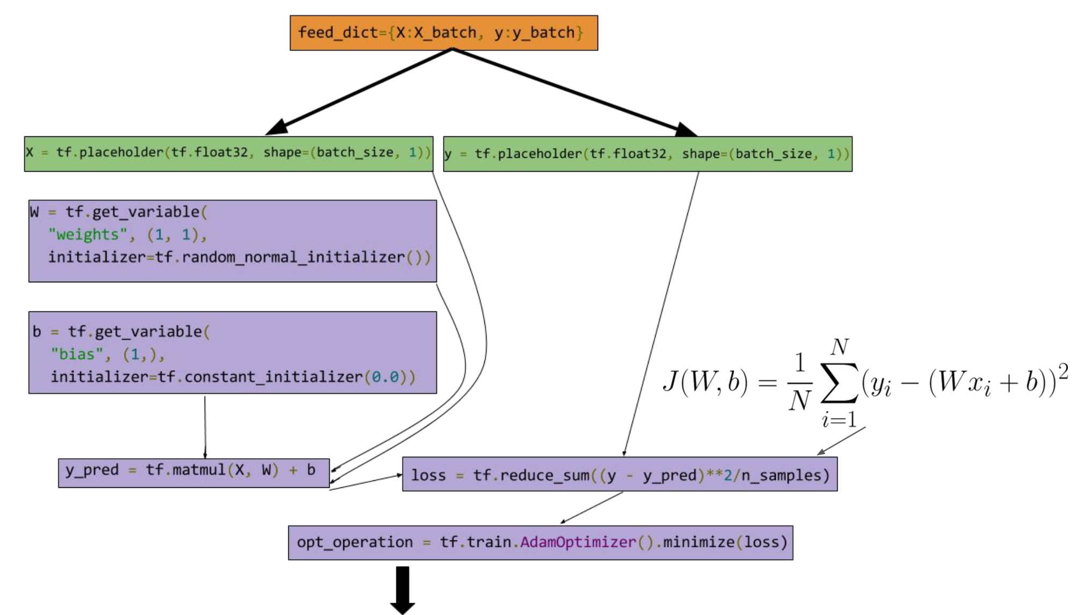
Linear regresssion

Slide 27
Coding practices:
Don’t write your entire graph at once. Instead, test each component with a feed & fetch run.
Keep good naming conventions for tensorflow variables. Otherwise no variable names during errors.
Use scopes for large projects (for tensorflow variables).
Write in numpy if you want a faster prototype => convert to tensorflow.

Slide 28
If you want to be hacky
Hacky:
activate = lambda x: tf.matmul(x, W['in'])
x_vec = tf.map_fn(activate, x)
“Professional”:
tf. …

Slide 29
Example code
Linear regression CNN

Slide 30
Sources Slides & Additional Reference:
These are amazing:
https://github.com/aymericdamien/TensorFlow-Examples
Tricks of the trade
https://home.zhaw.ch/~dueo/bbs/files/TF_Introduction.pdf
https://cs224d.stanford.edu/lectures/CS224d-Lecture7.pdf
https://www.tensorflow.org/programmers_guide/graphs

